Slide 1

AKS UNIVERSITY , SATNA
Department Of Computer Science
Minor Project
Presentation
On
DESKTOP VIRTUAL VOICE ASSISTANT
Submitted By
Under Guidance Of
Ankit Singh (B2192R10700036)
Asst. Prof. Brijesh K. Soni

Slide 2
Why Desktop Voice Assistant ?
Current Market Demand
Personal Assistant
Automate Works
Improves productiveness

Slide 3
Features And Security
Opening And Closing Applications
Web Browsing
Youtube Searches
Wikipedia Searches
Shutdown And Restart PC
Computational Intelligence
Live Weather Forecasting
Whatsapp Automation
Capability Of Learning New Things In Run Time
Face Recognition System (Security)

Slide 4
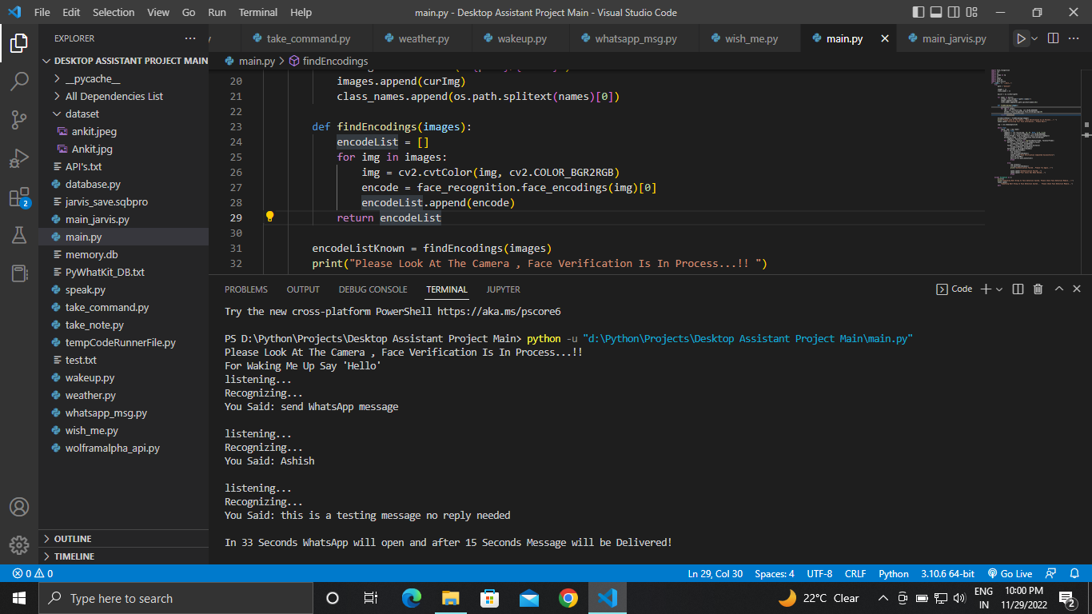
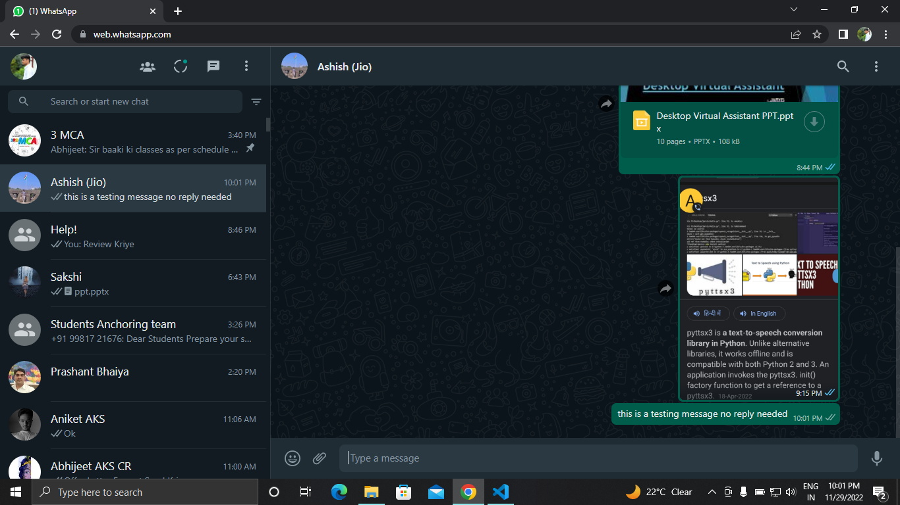
Whatsapp Automation Result
Command
Output
Recipient Name
Message

Slide 5
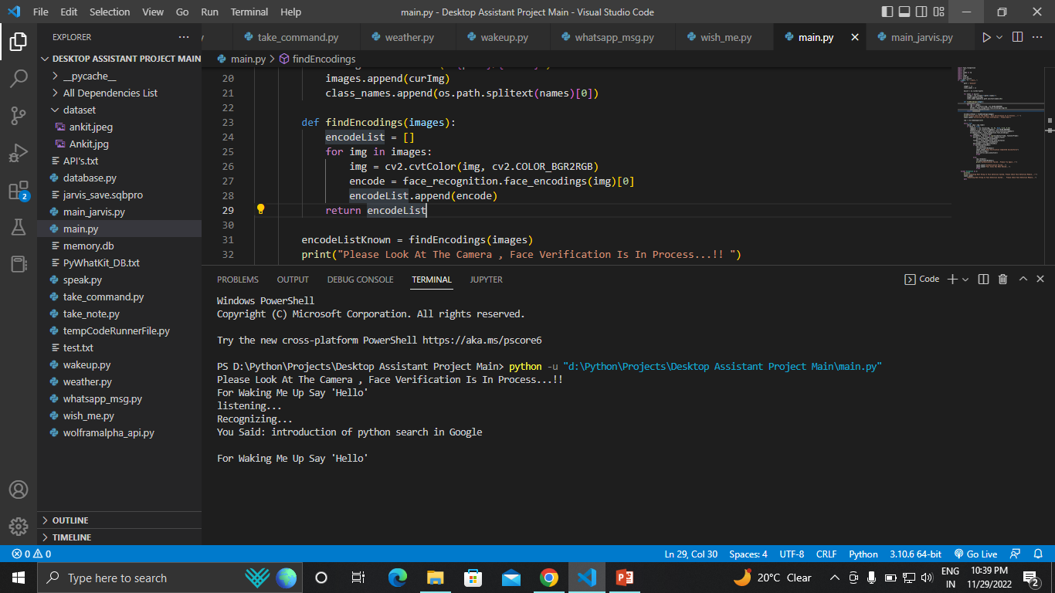
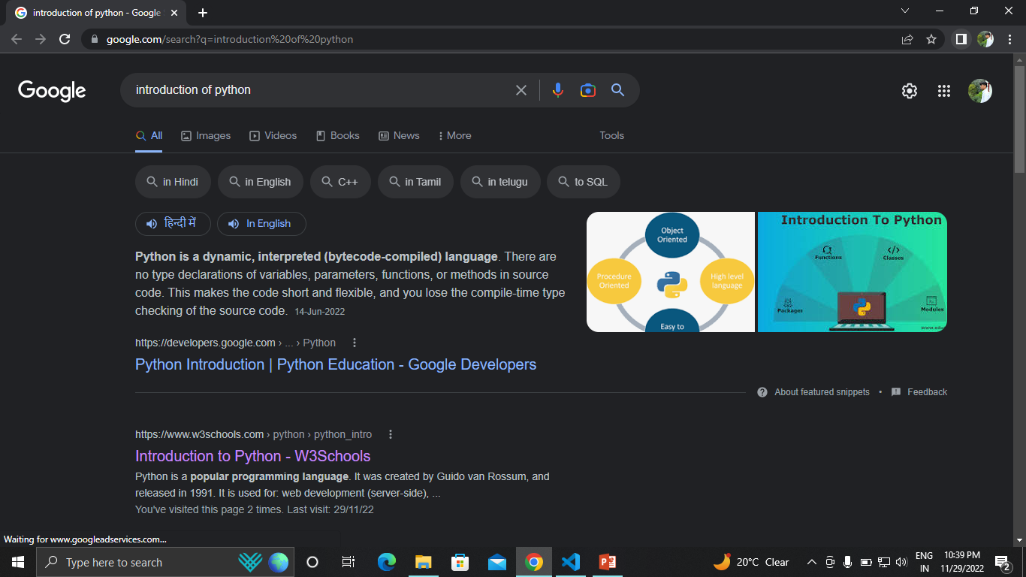
Web Browsing Result
Searching String
Query
Output Page

Slide 6
Technology Used
Frontend
Backend
Python 3.10.6
VS Code IDE
SQLite Database
Wolfram Alpha API
OpenWeatherMap API

Slide 7
Why Choosing Python ?
What Is Python ?
Advantages Of Python
Python is an interpreted, object-oriented, high-level programming language.
Created by Guido van Rossum in 1991.
It is used for:
Web Development (server-side),
Software Development,
Mathematics,
System Scripting,
Data Science,
Machine Learning.
Versatile, Easy to read, learn and write
Open source and large active community base
Extensive support libraries(NumPy for numerical calculations, Pandas for data analytics, etc.)
Presence of third-party modules.

Slide 8
What Is SQLite ?
SQLite is a self-contained, high-reliability, full-featured, SQL database engine.
Lite Version
Similar To SQL
What Is API ?
API stands for Application Programming Interface, which is a software intermediary that allows two applications to talk to each other.
Used API’s
OpenWeatherMap API
Wolfram Alpha API

Slide 9
Some Important Libraries
speech_recognition
microphone
recognize_google
Pyttsx3
say
face_recognition
face_encodings
Compare_faces
pywhatkit
Sendwhatmsg

Slide 10
Working Mechanism
API
Call
Voice Input
Speech Recognition Module
Content Extraction
Python Backend
Text To Speech Module
System Call

Slide 11
Conclusion
The destiny of these assistants may have the virtual assistants integrated with Artificial Intelligence which incorporates Machine Learning, Neural Networks and IoT. With this technology, we are able to gain new heights.
In future we are going to integrate artificial intelligence and machine learning.
Automation In Next Level.
Inspired From IRON MAN Movie

Slide 12
Thank You !

